Slide 1
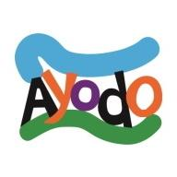
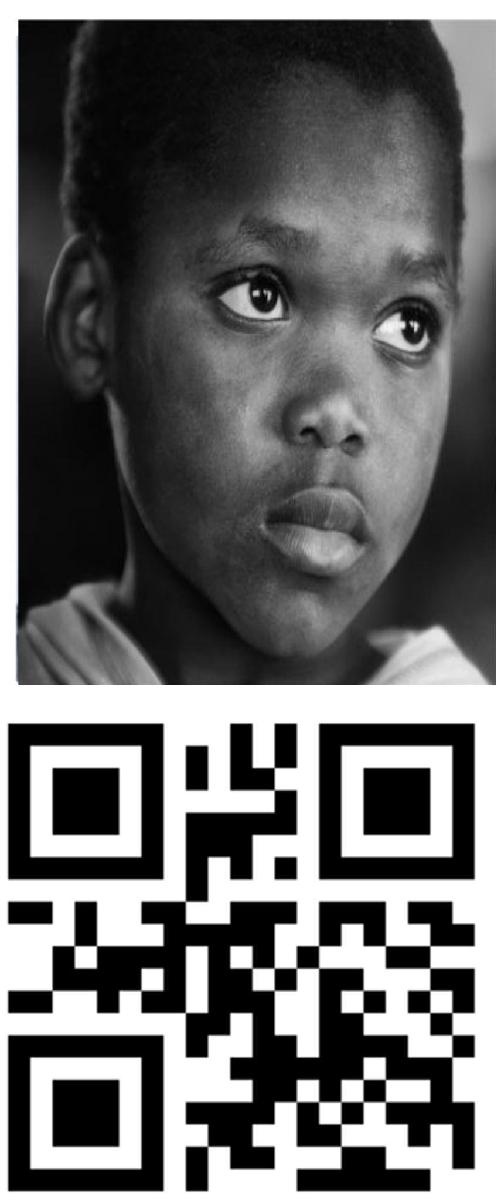
Universal Digital Identity
MQR
Ayodo Foundation a Registered Canadian not-for-profit corporation

Slide 2
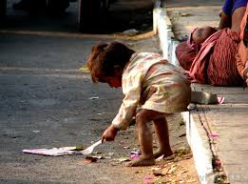
for Digital and Financial Inclusion
MQR
There are as many Digitally excluded individuals as there are Financially excluded individuals.
Solutions to enhance financial inclusion for the nearly half of humanity living on less than $5 per day - must extend and leverage the power of digital tools - to address the needs of these poorest individuals without exposing them to cyber crime.
Legacy Financial Service Providers & Mobile Network Operators have product sets at best marginal aligned for this Digitally excluded demographic representing fully a third of the global population.
Ayodo Foundation’s mandate is to develop innovative tools such as DID with face biometric on chain, which will extend both Digital and Financial services to those most needy. Imagine if you can providing Financial services to this young child.

Slide 3
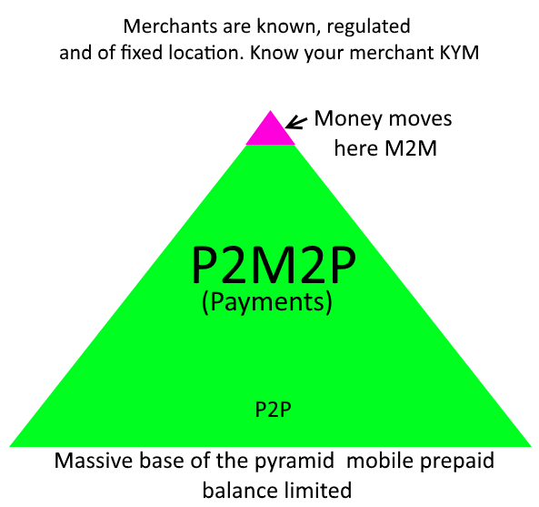
Ayodo Foundation’s
“Merchant Centric”
Solution
Know Your Merchant - KYM
www.moja.uno

Slide 4
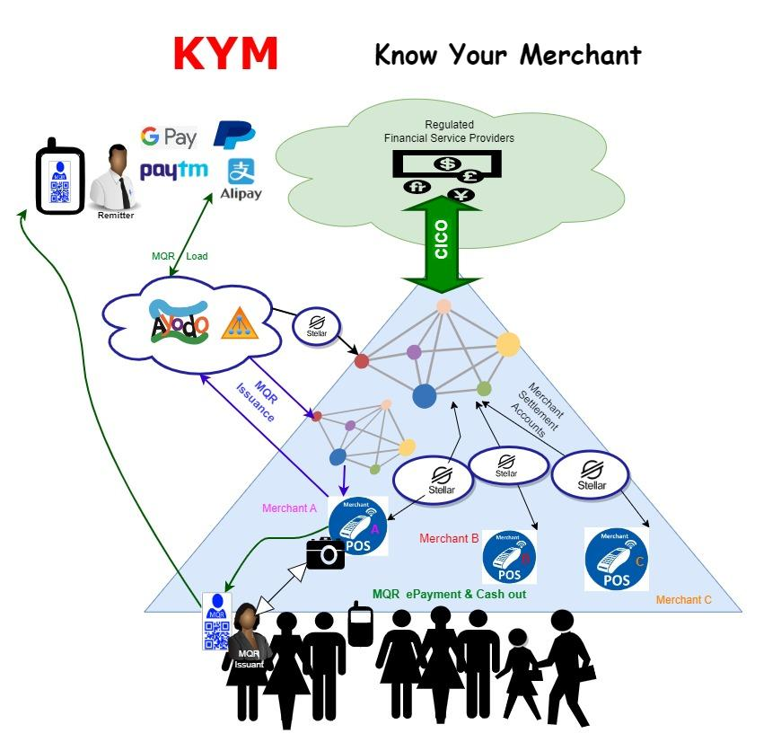
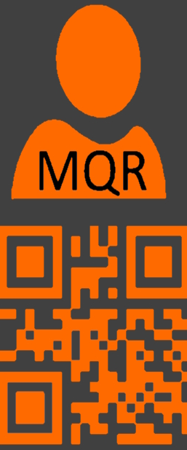
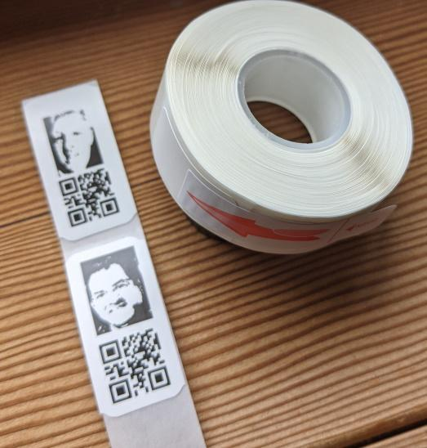

Slide 5
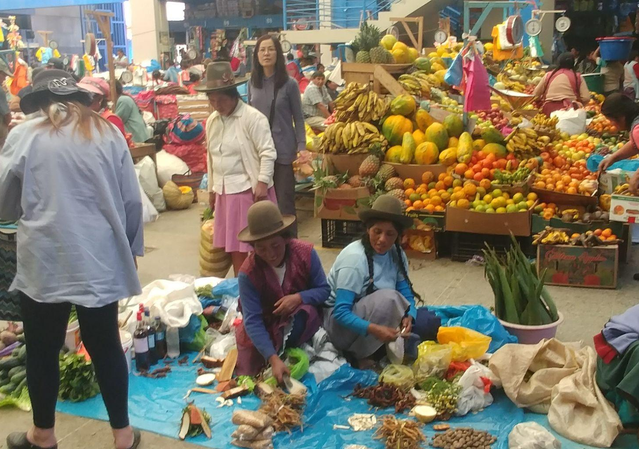
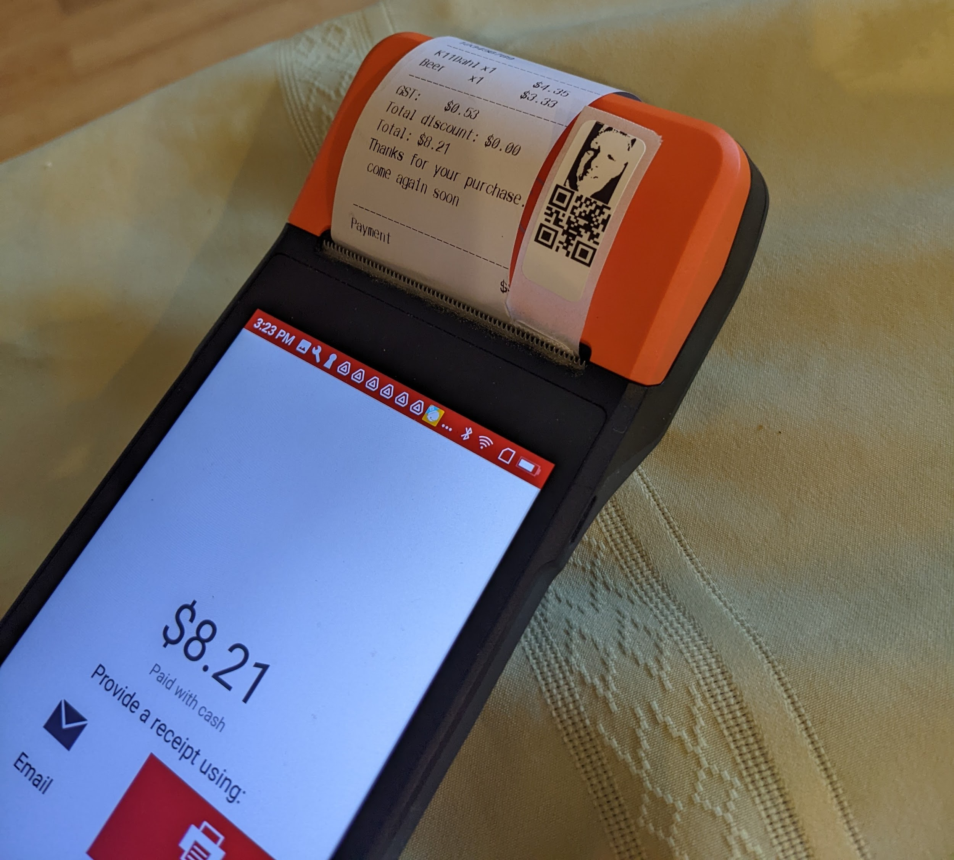
INCLUSIVE FINANCIAL SERVICES
Registered merchants are leveraged not only to provide CICO, but also to provide internet access via their own POS devices to digitally excluded customers.

Slide 6
Leverage the entire global open source DeFi - secure, self-Sovereign and so devoid of legacy FSP dependency that MQR may be used on a one-time-use basis
MQR
DID with face biometric on chain
Print it , wear it, keep it on your mobile. Use it once, use it twice, throw it away and ask for a new one. The three -cent solution anyone can load and only you can spend.
Acts like a limited lifetime crypto wallet for digitally and financially excluded or not

Slide 7
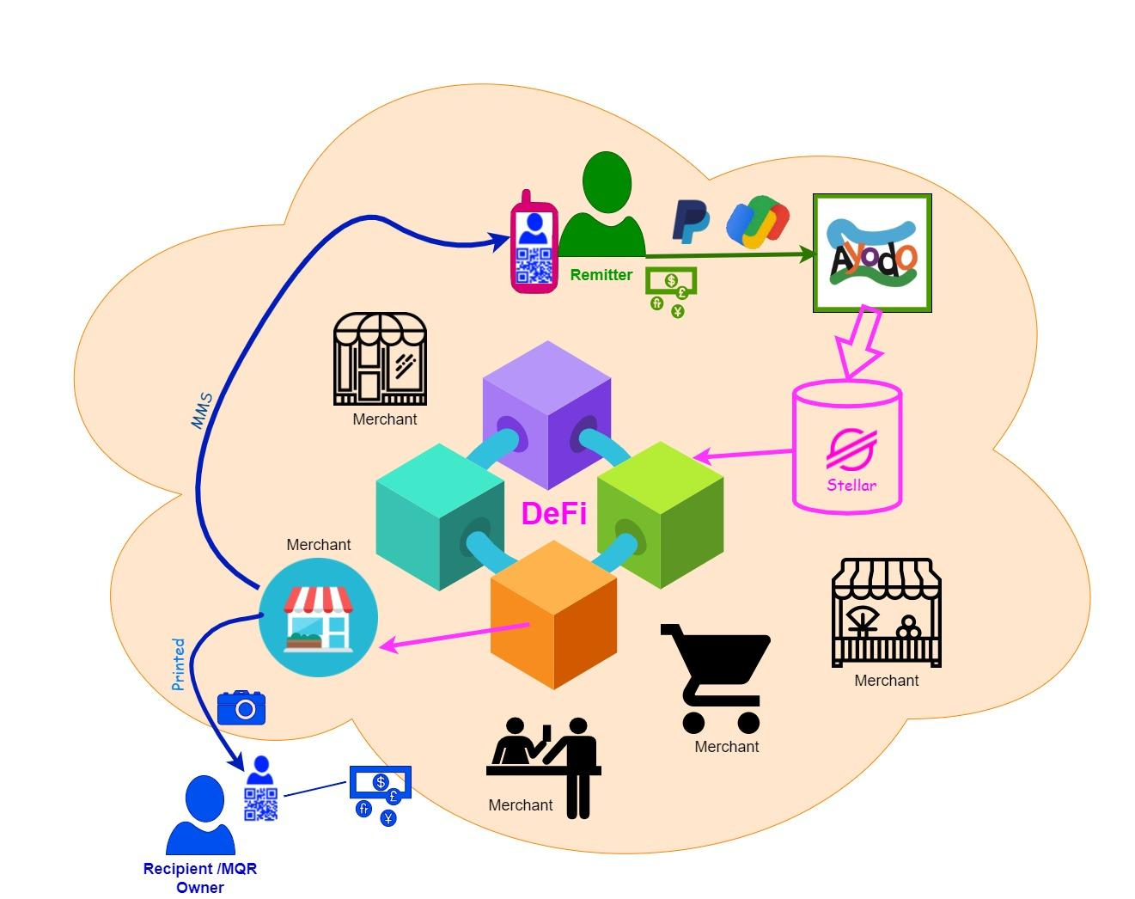
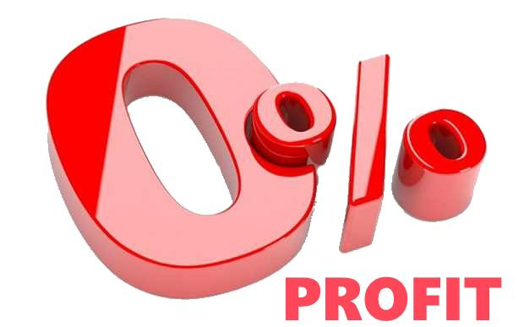
MQR
Typical Remit
Recipient requests the MQR
from a Merchant by providing
a facial image, plus possibly a remitter’s mobile number .
MQR is created on a Blockchain , issued to Recipient in printed format at the merchant location with a digital copy sent to the mobile number(s) provided.
Remitter loads MQR online to effect money Transfer.
Real time merchant settlement when MQR is cashed or spent via Stellar Network.

